Slide 1
Google Stock Price Prediction using LSTM
Presented By: DIWAGAR BK
Register No: 711721243024
Department: Artificial Intelligence and Data Science
3/21/2024 Annual Review

Slide 2
PROJECT TITLE
Google Stock Price Prediction using LSTM
3/21/2024 Annual Review

Slide 3


AGENDA
Problem Statement
Project overview
Who are the end users?
Our Solution and Value Proposition
The Wow in your solution
Modelling approach
Results and Evaluation
Conclusion
3/21/2024 Annual Review

Slide 4

PROBLEM STATEMENT
Create and deploy an LSTM neural network model to forecast future stock prices of Google (GOOGLE). Utilize historical stock price data alongside key features like trading volume, opening and closing prices, and other pertinent financial indicators for model training. The aim is to construct a reliable predictive model capable of accurately anticipating Google stock price movements within a defined time frame.

Slide 5

PROJECT OVERVIEW
The objective is to collect historical stock price data of Google (GOOGLE) along with pertinent financial indicators. Preprocess the data by cleansing, feature selection, and segmentation into training, validation, and testing subsets.
Develop the architecture of the LSTM neural network for stock price prediction, encompassing configuration of the input layer, hidden layers, and output layer. Train the model using historical data, fine-tune hyperparameters, and employ techniques such as regularization and early stopping for performance enhancement.
Assess the trained LSTM model using metrics like Mean Squared Error (MSE), Root Mean Squared Error (RMSE), Mean Absolute Error (MAE), and R-squared score. Contrast predicted prices against actual prices and visualize model performance.

Slide 6

WHO ARE THE END USERS?
Investors and Traders
Financial Analysts
Algorithmic Trading Platforms
Financial Software Developers
Academic Researchers
3/21/2024 Annual Review

Slide 7

YOUR SOLUTION AND ITS VALUE PROPOSITION
Our solution harnesses Long Short-Term Memory (LSTM) neural networks for stock price forecasting, seamlessly blending advanced machine learning methodologies with comprehensive financial analysis to precisely predict Google (GOOGL) stock prices.
BENEFITS:
By leveraging LSTM neural networks, our solution delivers unmatched precision, timely intelligence, fortified risk assessment, and decision-making support. It also offers scalability, flexibility, ongoing refinement, and ethical adherence, delivering tangible benefits to investors, analysts, and financial institutions navigating volatile financial landscapes.

Slide 8

THE WOW IN YOUR SOLUTION
Unparalleled Precision: Demonstrates outstanding accuracy in predicting Google (GOOGLE) stock prices, outperforming conventional approaches and furnishing dependable guidance to investors.
Dynamic Integration and Flexibility: Seamlessly integrates with live data streams, adjusts to evolving market dynamics, and furnishes timely guidance, empowering users to make well-informed choices in fluid market scenarios.
Practical Guidance and User-Friendliness: Equips users with practical insights via an intuitive interface, facilitating informed decision-making and strategic foresight, all while upholding ethical principles.
3/21/2024 Annual Review
8

Slide 9
MODELLING
1.) Model Architecture: The LSTM neural network architecture is selected for its capacity to capture prolonged dependencies within time-series data. It consists of sequential layers comprising LSTM layers employing suitable activation functions (e.g., tanh), along with an output layer designed to predict future stock prices.
2.) Data Preprocessing: A robust cleaning methodology is implemented to address missing values, outliers, and inconsistencies within the historical stock price dataset. This includes comprehensive feature selection and extraction to discern pertinent predictors such as trading volume, opening price, and the preceding day's closing price.
3.) Training Procedure: The training dataset is utilized to iteratively refine model parameters via backpropagation and gradient descent. This involves employing suitable loss functions (e.g., Mean Squared Error) to quantify prediction discrepancies and optimization algorithms (e.g., Adam optimizer) to facilitate efficient parameter updates.
9

Slide 10
MODELLING
4.) Evaluation:
Calculation of key evaluation metrics including Mean Squared Error (MSE), Root Mean Squared Error (RMSE), Mean Absolute Error (MAE), and R-squared (R2) score to assess model performance.
Visualization of model predictions against actual stock prices through plots and charts to evaluate accuracy and reliability.
5.) Fine Tuning and Optimization:
Systematic hyperparameter tuning to optimize model performance, including experimentation with batch sizes, learning rates, and architectural configurations.
Exploration of advanced techniques such as ensemble methods or transfer learning to further enhance prediction capabilities.
6.) Deployment:
Packaging of trained model along with necessary dependencies and configurations for deployment in a production environment.
Development of APIs or integration points for seamless integration with existing systems or applications.
Implementation of robust monitoring and logging mechanisms to track model performance and usage in real-time.
10

Slide 11
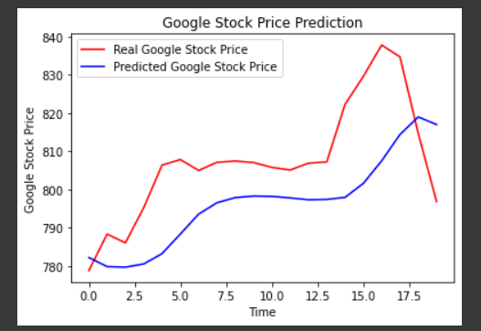
RESULTS
11

Slide 12
CONCLUSION
The LSTM-based stock price prediction model embodies the convergence of technology and finance, presenting a progressive solution to the complexities of investment decision-making.
Backed by its demonstrated accuracy, adaptability, and ethical foundation, this model heralds a transformative shift in how investors engage with stock market analysis.
Its potential to deliver timely insights and informed predictions has the capacity to reshape investment strategies and enhance risk management practices.
This model impact is anticipated to extend far beyond traditional approaches, fostering a new era of data-driven decision-making in the financial landscape.
12

